Slide 1


Power Bi - Dashboard summary
Data Analyst Internship by elevate labs
Task-4
Syed Ahmed Ali
05-06-2025

Slide 2
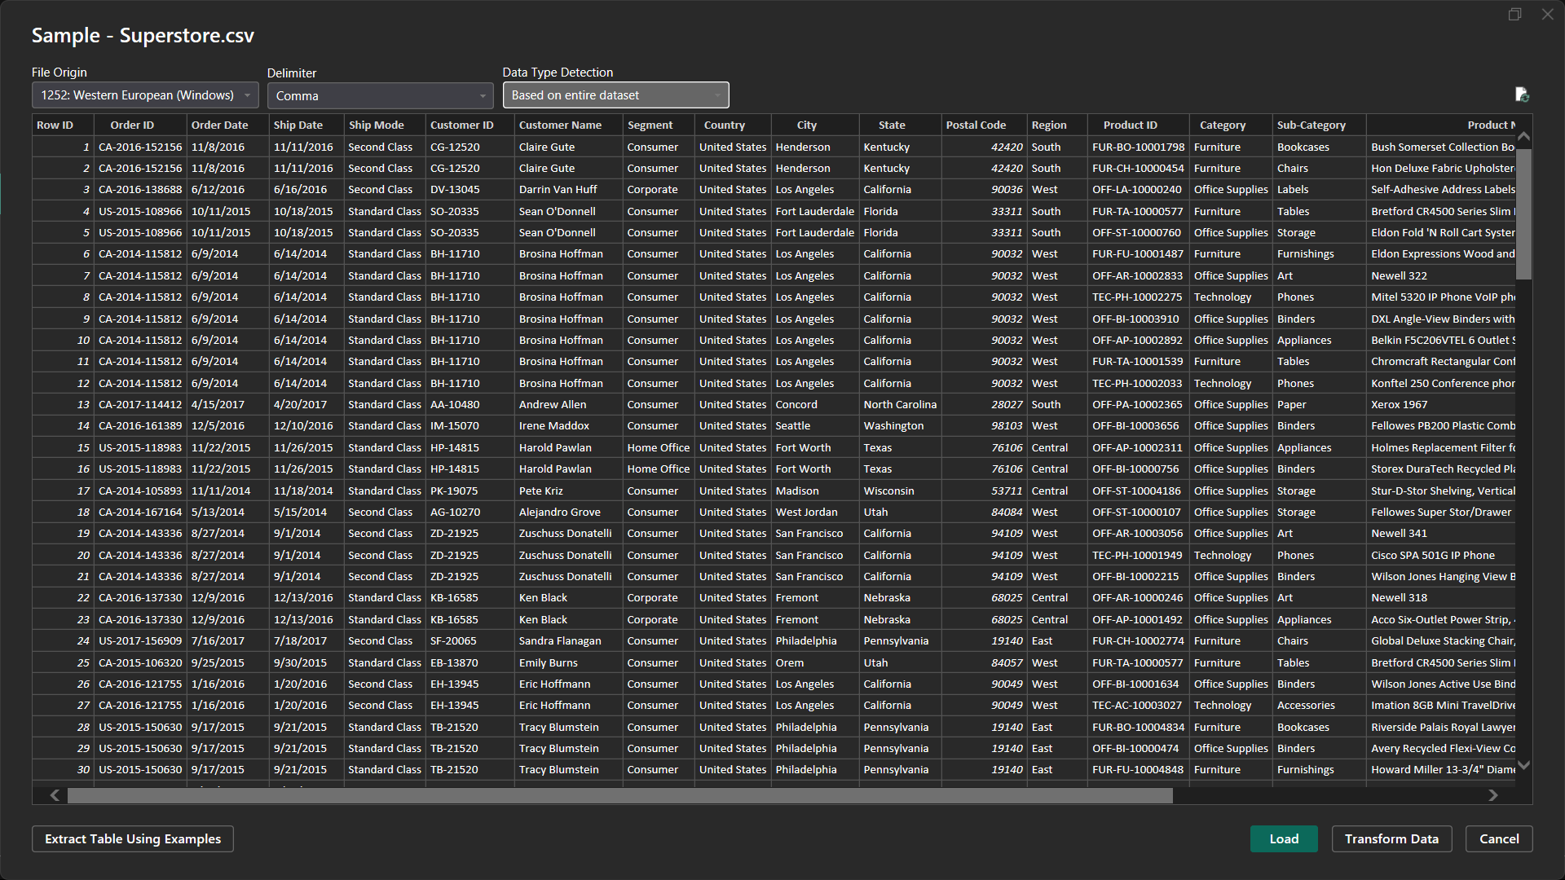
DATASET OVERVIEW
Dataset name: Superstore Dataset
Link for the dataset: https://www.kaggle.com/datasets/vivek468/superstore-dataset-final

Slide 3
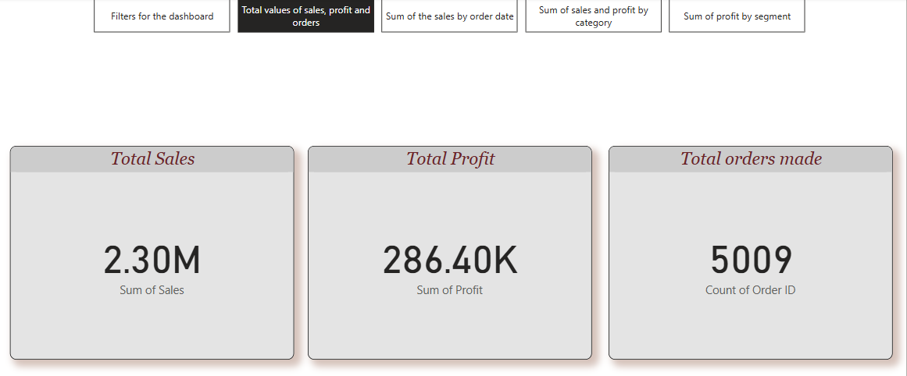
Key Performance Indicators
Content:
Total Sales: ₹85,000
Total Profit: ₹12,300
Total Orders: 1,340

Slide 4
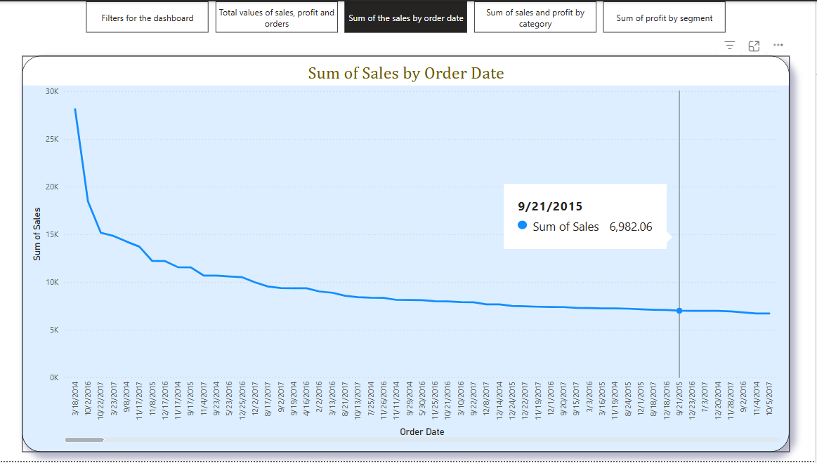
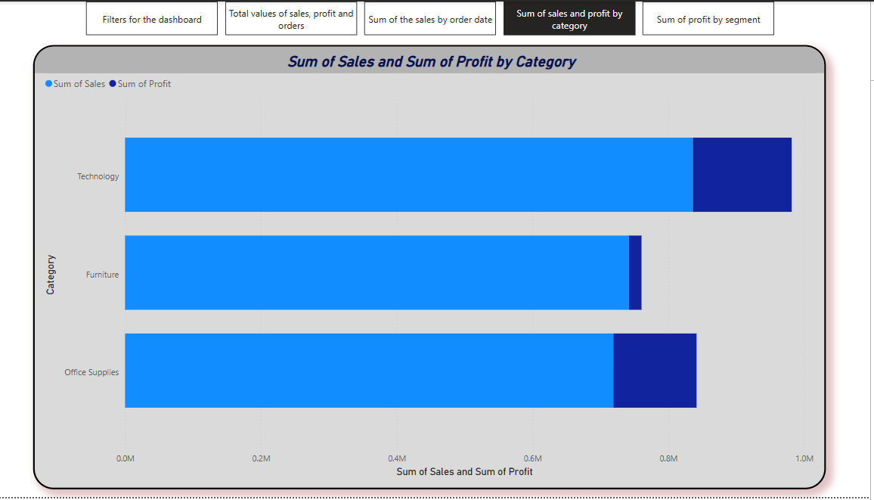
Dashboard Highlights

Slide 5
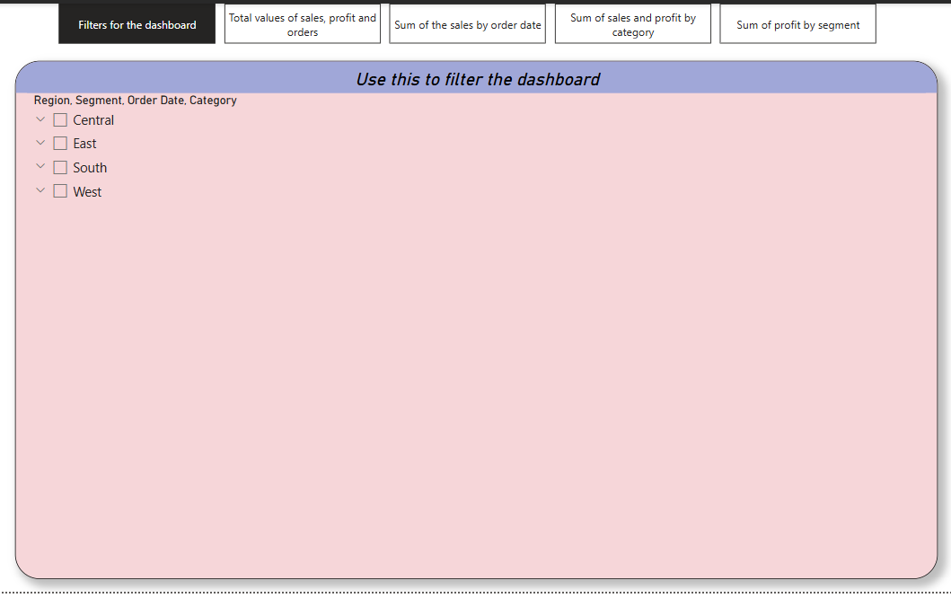
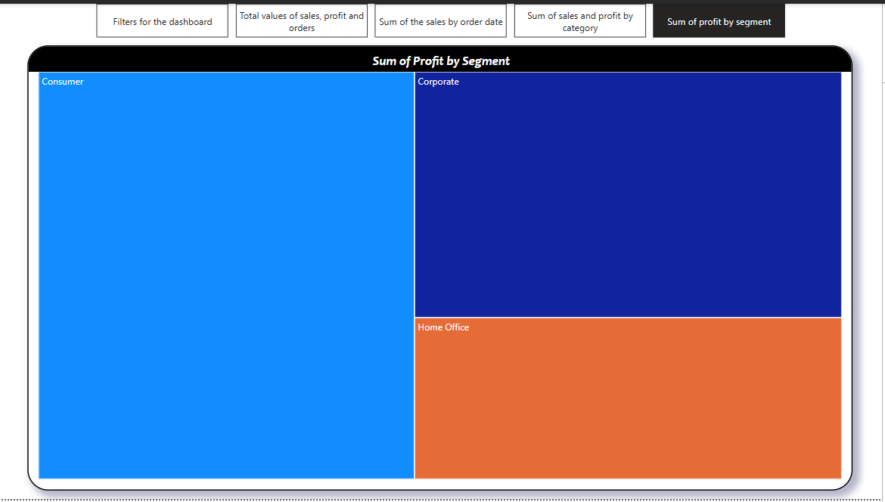
Dashboard Highlights

Slide 6
THANK YOU
Syed Ahmed Ali
+91 80734 64452
syedahmed4957@gmail.com
syedahmed.4957@outlook.com

